Slide 1
Spring Cloud
Start Up

Slide 2
Contents
Main Ideas
1 Monomer Application Vs Micro-Service Application
2 Spring Cloud Overview
3 Service Register and Discovery (Eureka)
4 Service Consume and Client Load Balance (Rest -> Ribbon -> Feign)
5 Circuit Breaker (Hystrix & Hystrix Dashbord)
6 Router and Filter (Zuul)
7 Externalized Configuration(Spring Cloud Config)
8 A demo example

Slide 3
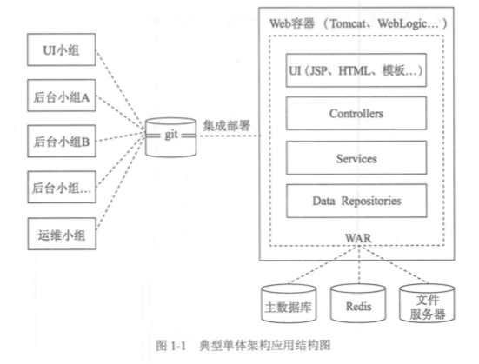
Monomer Application Vs Micro-Service Application
Monomer Application
Business expand
Development
Compile
Test
Deploy
Maintenance
Complicated
Single technology
Not Stable

Slide 4
Monomer Application Vs Micro-Service Application
Micro-Service Application
Loose Coupling
Independent
Development
Deploy
technology
Simple
Elasticity
Shortage
Low availability
Distributed problem
Business Split
Resource demand

Slide 5
Spring Cloud Overview
Overview
A set of tools for common patterns in distributed System
e.g. configuration management, service discovery,
circuit breakers, intelligent routing, micro-proxy,
control bus, one-time tokens, global locks,
leadership election, distributed sessions, cluster state
Use for building and deploying microservices
Develop with Spring Boot

Slide 6
Service Register and Discovery
Eureka

Slide 7
Service Consume and Client Load Balance
RestTemplate
Sample: public stattic UserVo getUser (Long id) { RestTemplate restTmpl =new RestTemplate();
UserVo userVo = restTmpl .getForObject( ”http://localhost:8080/user/{id}”, UserVo.class, id);
return userVo; }
public RestTemplate()
public RestTemplate(ClientHttpRequestFactory requestFactory)
public RestTemplate(List<HttpMessageConverter<?>> messageConverters)

Slide 8
Service Consume and Client Load Balance
RestTemplate + Ribbon
Ribbon is a client side load balancer
which gives you a lot of control over the behavior of HTTP and TCP clients

Slide 9
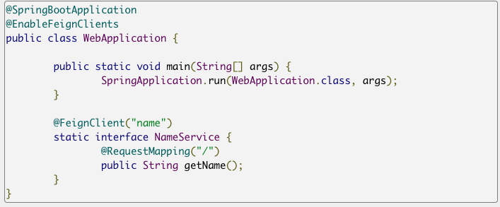
Service Consume and Client Load Balance
Feign
Declarative REST Client:
Feign creates a dynamic implementation of an interface decorated with JAX-RS or Spring MVC annotations

Slide 10
Circuit Breaker
Hystrix & Hystrix Dashbord
Loose Coupling

Slide 11
Router and Filter
Zuul
Loose Coupling

Slide 12
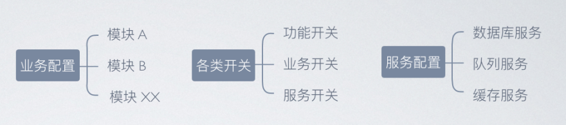
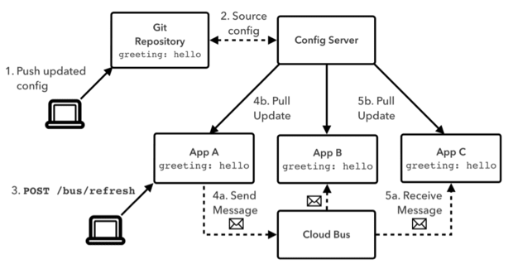
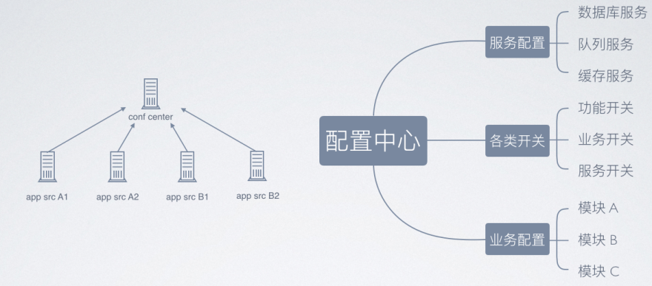
Externalized Configuration
(Spring Cloud Config)

Slide 13
A Demo Example
Hystrix & Hystrix Dashbord
Loose Coupling

Slide 14
Thank you

